Slide 1
Chapter 11
Switches

Slide 2
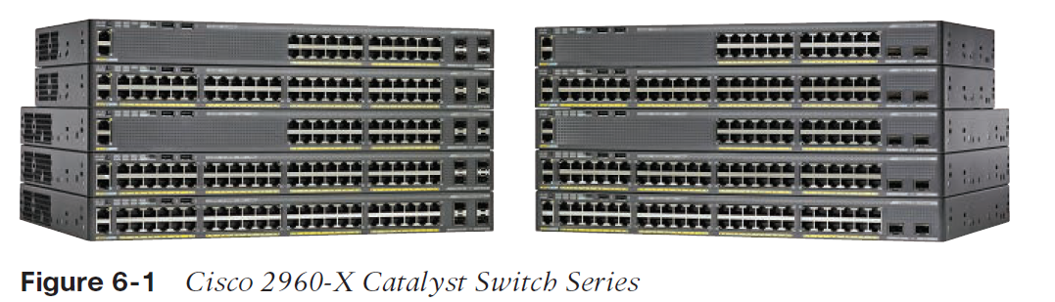
Switches
Three Functions
Address Learning
Forwarding decisions
Loop Prevention
Notes:
Connects servers, computers, printers, and other devices across a network

Slide 3
Switches Cont.
Layer 2 Devices
Uses MAC Address to figure out where Packets go
Potential for routing loops (STP)
Layer 3 Switches
Allows you to talk between Networks and out to the INTERNET

Slide 4


Address Learning
MAC Forward/Filter Table
E0/0:
E0/1:
E0/2:
E0/3:
E0/0
E0/3
Layer 2 switches and bridges are capable of address learning; they remember the source hardware address of each frame received on an interface and enter this information into a MAC database known as a forward/filter table.
Initially there is no address information in the table.
E0/1
E0/2
Host A
Host B
Host C
Host D
Notes:
When the switch receives data from a source, it remembers its MAC address and which interface it came from on the switch

Slide 5

Forwarding/Filter Table
MAC Forward/Filter Table
E0/0: 0000.8c01.000A Step 2
E0/1: 0000.8c01.000B Step 4
E0/2:
E0/3:
When the hosts start communicating, the switch places the source hardware address of each frame in the table along with the corresponding port
E0/0
E0/3
Step 1
E0/1
E0/2
3
4
3
3
Host A
Host B
Host C
Host D
Notes:
Host A sends a frame to Host B, the switch doesn’t know where Host B is

Slide 6
Forwarding/Filter Table Evaluation
Switch#sh mac address-table
VLAN Mac Address Ports
-------- ------------------- --------
1 0005.dccb.d74b Fa0/4
1 000a.f467.9e80 Fa0/5
1 000a.f467.9e8b Fa0/6
Host A is sending a data frame to Host D.
What will the switch do when it receives the frame from Host A?
Fa0/3
Fa0/4
Fa0/5
Fa0/6
A
B
C
D
Notes:
If the destination address is known, the frame will only be sent to that destination address
Host A sends a packet to Host D
Send the frame to Host D and add Host A’s MAC address to its table

Slide 7
Loops
Switched network with a redundant topology (switching loops) without some type of Layer 2 mechanism to stop network loops will fail.
Notes:
Loops can occur because there is no timer at the MAC address level
A loop can easily be created by simply plugging 2 cables into two switches
Easy way to bring down the network

Slide 8
Spanning Tree Protocol (STP)
STP prevents loops within the network
Using Root switch
Port States based on Root Port
Blocking
Listening
Learning
Forwarding
Disabled
STP Convergence
Rapid STP
Discarding
Learning
Forwarding
Notes:
Blocking: Blocks all traffic in/out of an interface if a loop would be created
Listening: This port listens for loops and forwards frames when it is clear
Learning: Adds MAC addresses to the MAC table
Forwarding: Sends and receives all data frames on the bridged port
Disabled: As a Admin you can disable the port
STP Convergence: happens when all the ports on bridges and switches have transitioned to either forwarding or blocking modes
No data will be forwarded until convergence is over
Usually takes 30-50 seconds to go from blocking to forwarding mode
Rapid Spanning Tree Protocol (RSTP): Convergence occurs in 6 seconds
Discarding: In the discarding state, no user data is sent over the port.
Learning: In the learning state the ports learn about the MAC address but it doesn’t forward any frames.
Forwarding: In the forwarding state the ports can send data and are fully operational.

Slide 9
Spanning Tree Protocol (STP)
STP’s main task is to stop network loops from occurring on your Layer 2 network (bridges or switches).
It achieves this feat by vigilantly monitoring the network to find all links and making sure that no loops occur by shutting down any redundant ones.
STP uses the spanning-tree algorithm (STA) to first create a topology database and then search out and destroy redundant links.
With STP running, frames will be forwarded only on the premium, STP-picked links.
Switches transmit Bridge Protocol Data Units (BPDUs) out all ports so that all links between switches can be found.
Notes:
The main task of STP is to stop network loops from occurring on your layer 2 bridges or switches
It uses Spanning Tree Algorithm to shut down redundant links

Slide 10
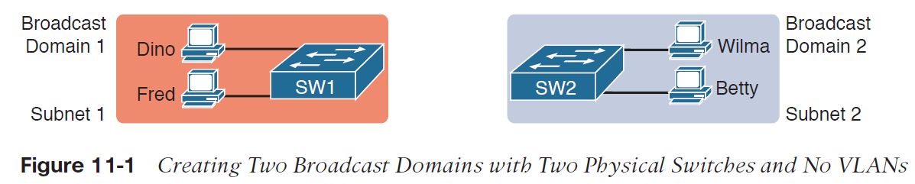
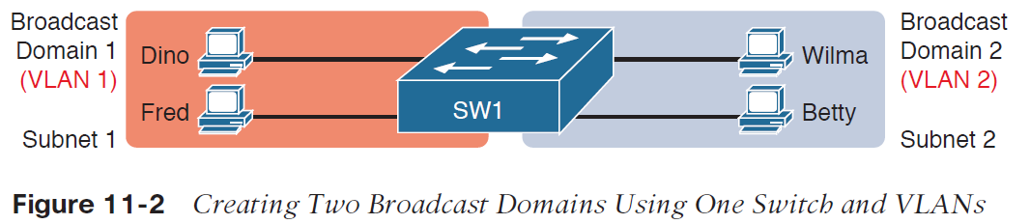
Virtual LANS (VLANs)
Notes:
A group of devices on a broadcast that are physically on the same switch, but logically (virtually) separate

Slide 11
Quality of Service (QoS)
Delay
Dropped Packets
Error
Jitter
Out of Order Delivery
Notes:
Allows you to add priority for one or more types of traffic over other types of traffic
It ensures that applications with high priority receive the necessary bandwidth

Slide 12
VLAN Membership
Static VLANs
Creating static VLANs is the most common way to create a VLAN, and one of the reasons for that is because static VLANs are the most secure.
Dynamic VLANs
On the other hand, a dynamic VLAN determines a host’s VLAN assignment automatically. Using intelligent management software, you can base VLAN assignments on hardware (MAC) addresses, protocols, or even applications that work to create dynamic VLANs.
Notes:
Statically assigning VLANs is one of the most common troubleshooting issues because it can get misconfigured easily when you have hundreds of devices on several switches

Slide 13
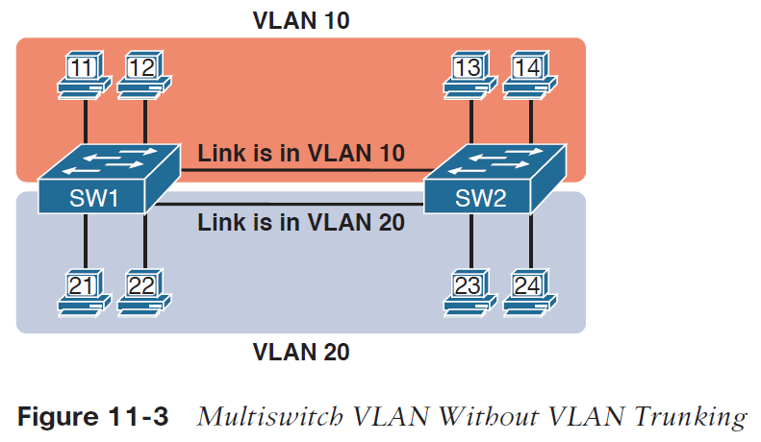
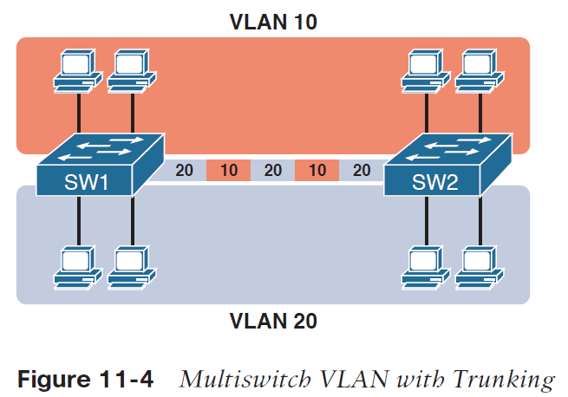
VLAN Trunking Protocol (VTP)
VTP Modes
Server
Client
Transparent
Notes:
Server: Main vector of utilization for management, creation, changing, or deleting VLANs. Making changes on this server will have the same effect on the clients as well
Client: gets its information from the VTP server that has already been configured, cannot add, delete, or modify VLANs
Transparent: Allows remote switches to receive the VLAN database from a VTP-server-configured switch through a switch that is not participating in the same VLAN assignments. Does NOT participate in the VTP domain

Slide 14
VLAN Trunking Protocol (802.1q)
Consistent VLAN configuration across all switches in the network
Accurate tracking and monitoring of VLANs
Dynamic reporting of added VLANs to all switches in the VTP domain
Adding VLANs using Plug and Play
Port Tagging/802.1q (Dot1q) – IEEE for VTP
Notes:
Trunk Ports are configured on switches in order to pass along data frames across switches for their respective VLANs
VLAN IDs are assigned to each frame
Can use a single connection to extend VLANs across two physically separate switches
Also referred to as 802.1q or DOT1Q
VLAN IDs are 12 bits long, so you get 4,094 different VLANs
VLAN 0 and VLAN 4095 are reserved numbers
VLAN 1 is the default Native VLAN
Port Tagging: A non-tagged frame is associated the default VLAN

Slide 15







Switches Removing the Physical Boundary
VLAN2
VLAN3
VLAN4
VLAN2
VLAN7
VLAN3
VLAN3
VLAN6
VLAN5
VLAN5
VLAN6
VLAN4
Marketing VLAN2 172.16.20.0/24
Shipping VLAN3 172.16.30.0/24
Engineering VLAN4 172.16.40.0/24
Finance VLAN5 172.16.50.0/24
Management VLAN6 172.16.60.0/24
Sales VLAN7 172.16.70.0/24
Provides inter-VLAN
Communication and
WAN services
Notes:
You can place an individual anywhere in a company building and setup the port that they are on to the respective department/VLAN that they belong to
Each VLAN is a separate subnet or network
You can place people on the same subnet and in the same VLAN that are physically on different switches

Slide 16
Port Security
Each interface has its own unique configuration
Configure a max number of MAC addresses per interface
Configure specific MAC addresses
Once the limit is reached or rule is broken, the interface is disabled
Notes:
Port security: prevents unauthorized users from connecting to an interface on a switch

Slide 17
Advanced Features
Power over Ethernet
802.3af/802.3at
Port Mirroring/Spanning
Notes:
802.3af: original PoE standard; 15.4 watts of DC power
802.3at: updated version of PoE; 25.5 watts of DC power
Both are part of the 802.3 Ethernet standards

Slide 18
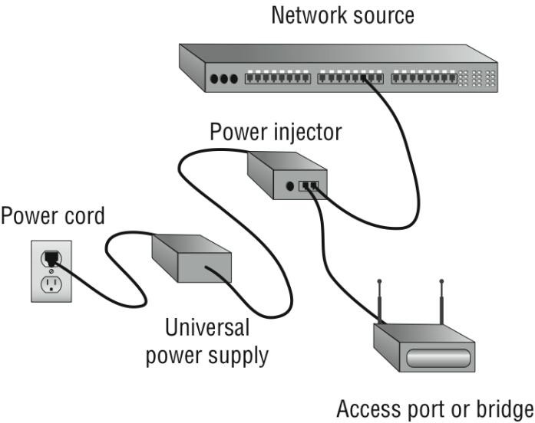
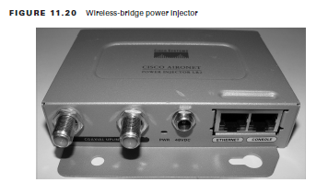
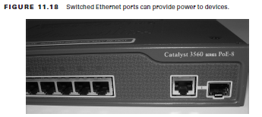
Power over Ethernet (PoE)
Switches can provide power to end devices by injecting power into the Ethernet cabling.
If PoE switches are not implemented, power can be injected into the cabling outside the switch.
Notes:
You can plug in an access point or cameras and get power from the switch
PoE: transmits electrical power, along with data, to remote devices over standard twisted-pair cable in an Ethernet network

Slide 19
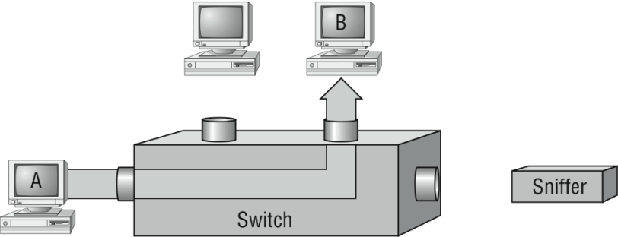
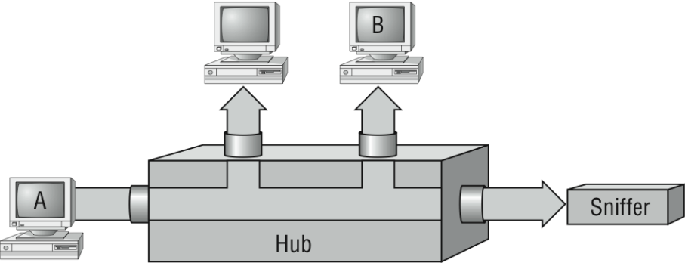
Port Mirroring/Spanning
Port mirroring, also called Switch Port Analyzer (SPAN), allows you to sniff traffic on a network when using a switch.
A problem with this arises when you need to sniff traffic on a switched network. The sniffer cannot see data going from Host A to Host B.
To solve this little snag, you could temporarily place a hub between Host A and Host B.
Notes:
Allows you copy all traffic from one or more interfaces and mirror the traffic to use for packet captures

Slide 20
Port Mirroring
B
A
Sniffer
The port-mirroring option allows you to place a port in spanning mode so that every frame from Host A is captured by both Host B and the sniffer.

